Slide 1
SQL Analysis of Gold Loan Data
By:- Virendra Raikwar
Part-I

Slide 2
Introduction
This is a data analysis project conducted using MySQL, where I created six different tables related to the gold loan segment. Through this project, I aim to showcase my understanding of SQL. This is part one of the project, and I plan to share a second part featuring more advanced queries commonly used in real-world scenarios. The data used in this project is synthetic.

Slide 3
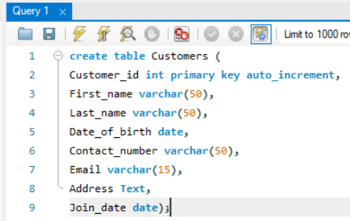
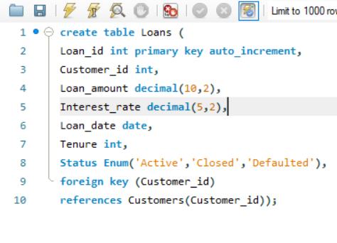
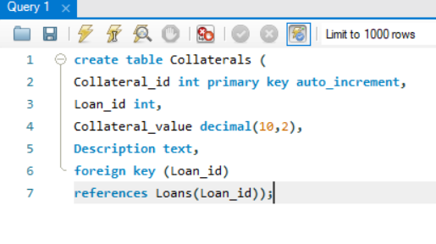
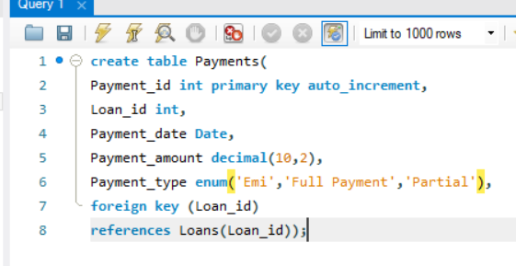
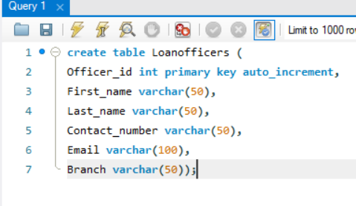
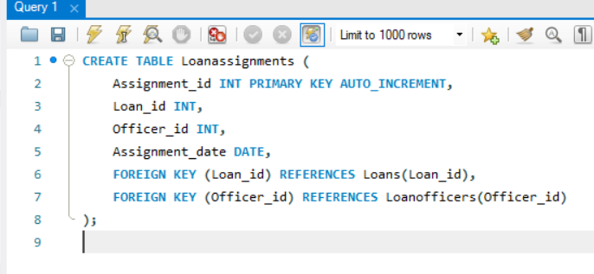
Creating Tables

Slide 4
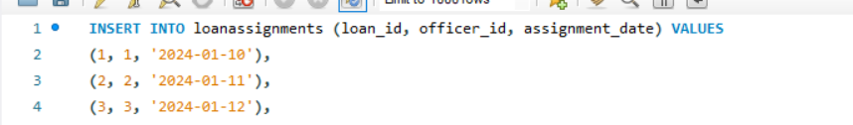
Data Insertion

Slide 5
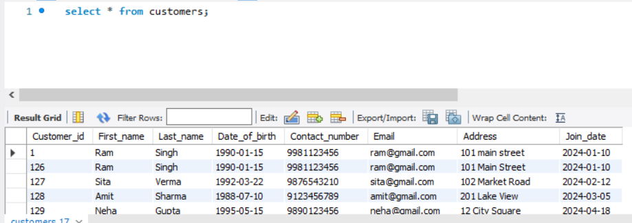
1.Select all customers details.

Slide 6
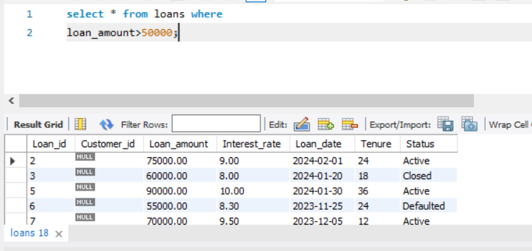
2.Retrieve loans greater than a specific amount.

Slide 7
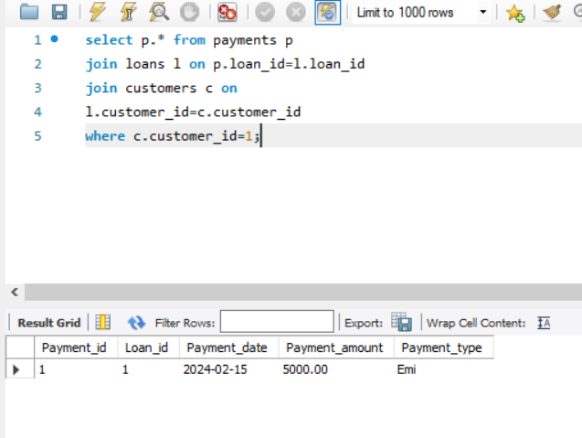
3.Find payments made by a specific customer

Slide 8
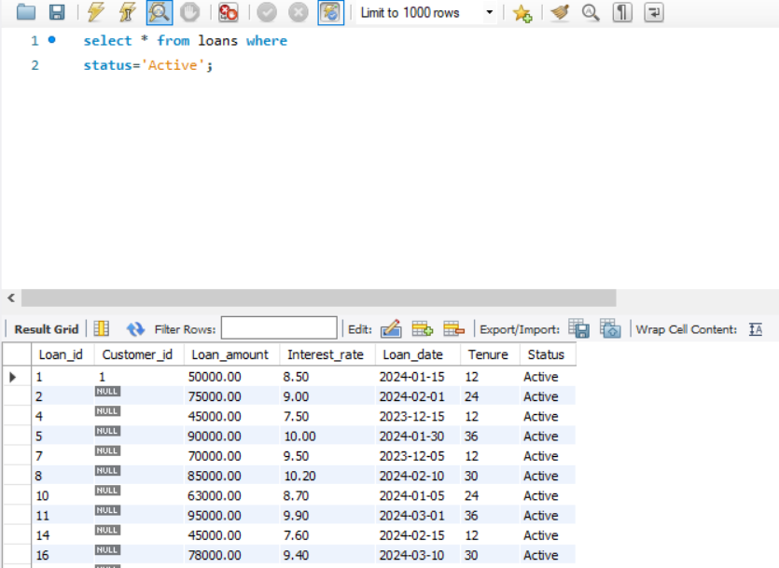
4.List all active loans

Slide 9
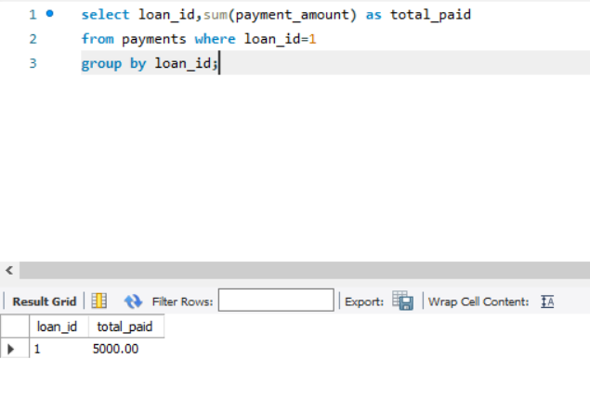
5.Calculate total payments made for a specific loan.

Slide 10
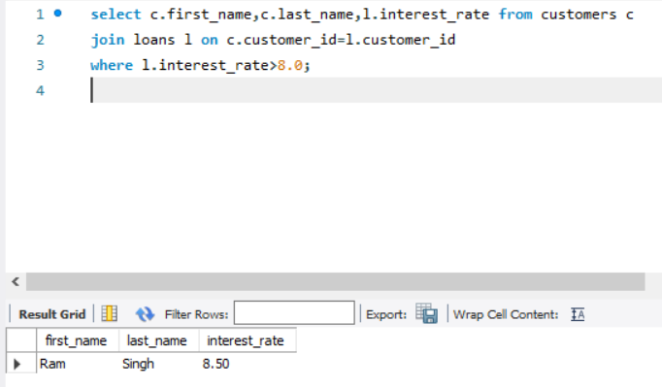
6.Identify customers with loans above a certain interest rate.

Slide 11
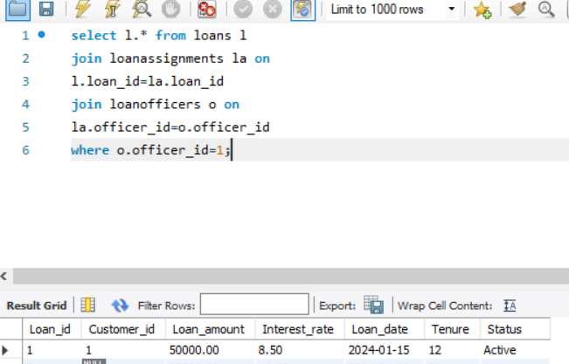
7.Fetch all loans assigned to a speific officer

Slide 12
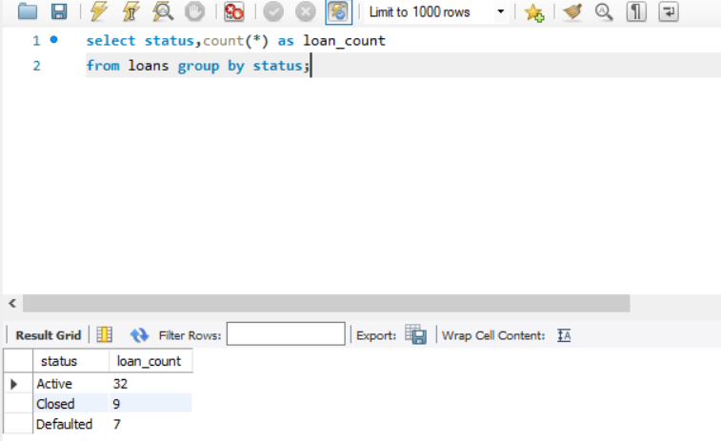
8.Count the number of loans by status

Slide 13
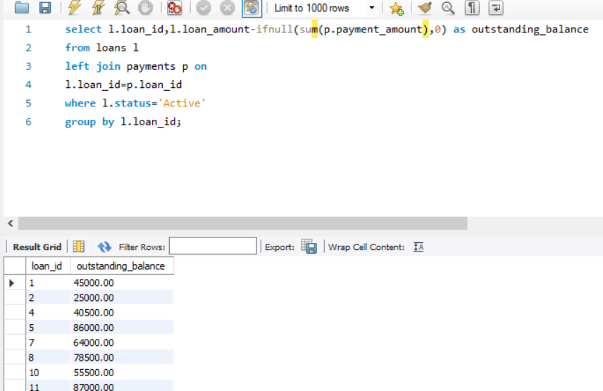
9.Calculate the outstanding balance for each loan.

Slide 14
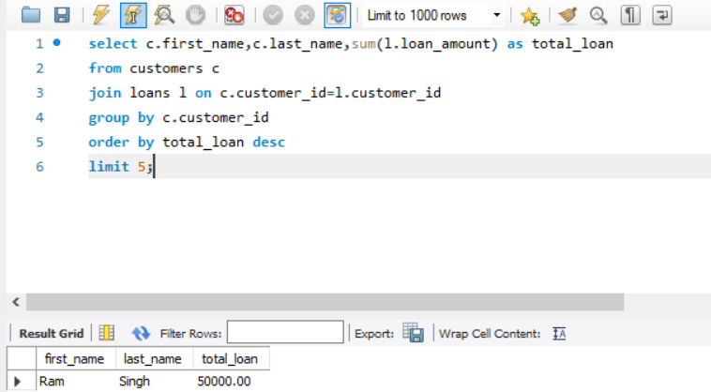
10.List the top 5 customers by loan amount.

Slide 15
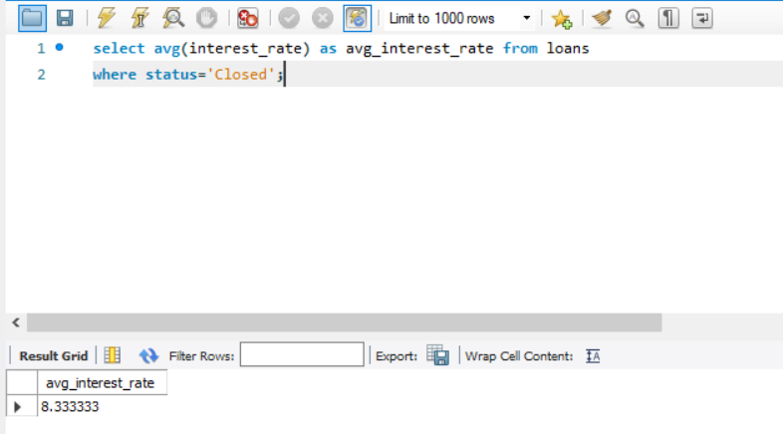
11.Find the average interest rate of closed loans

Slide 16
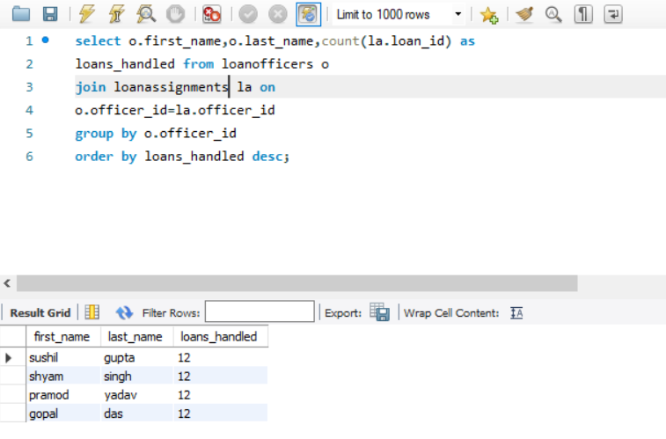
12.Retrieve loan officer performance by total loans handled

Slide 17
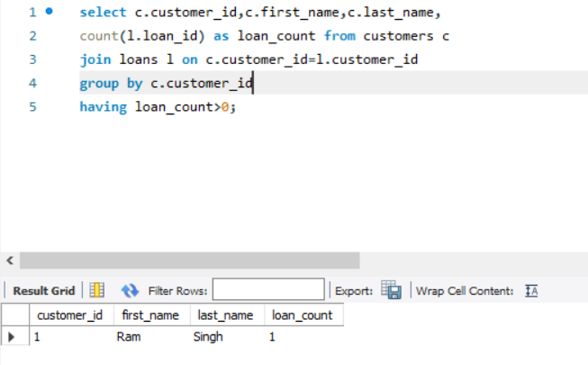
13.Find customers who have taken multiple loans

Slide 18
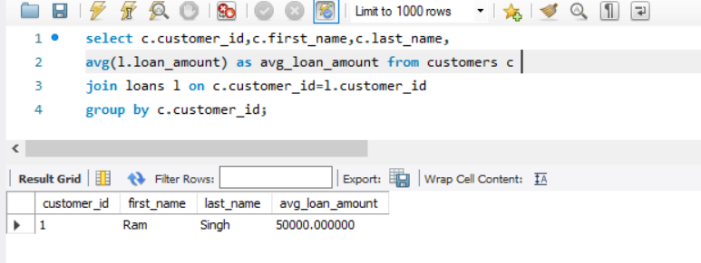
14.Calculate the average loan amount for each customer

Slide 19
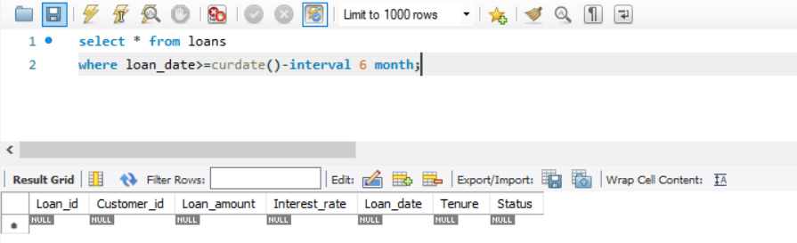
15. List all loans taken in the past 6 month

Slide 20
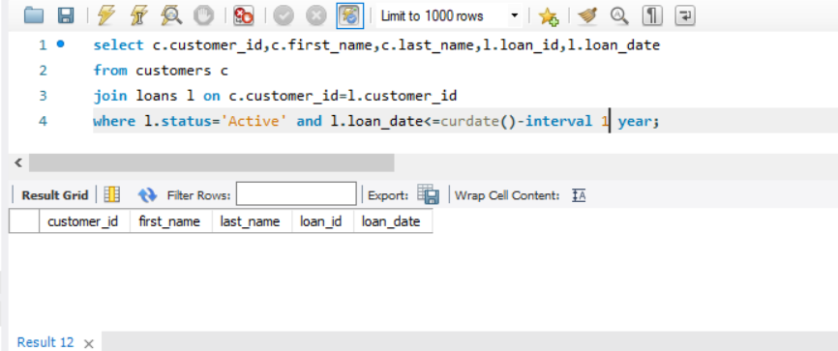
16.Identify customers with loans overdue by more than a year(for active loans)

Slide 21
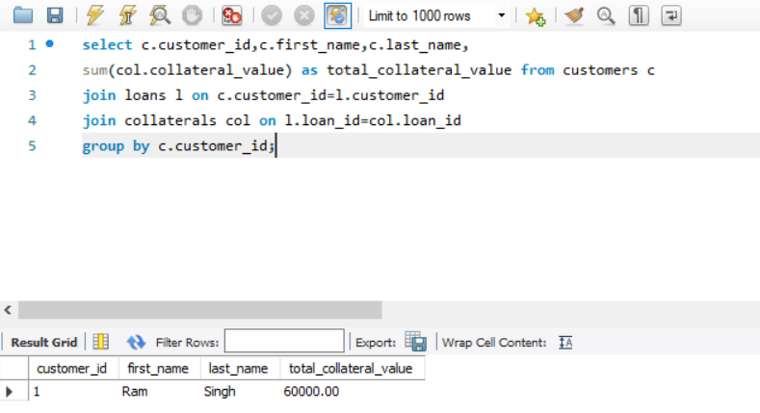
17.Calculate the total collateral value for each customer

Slide 22
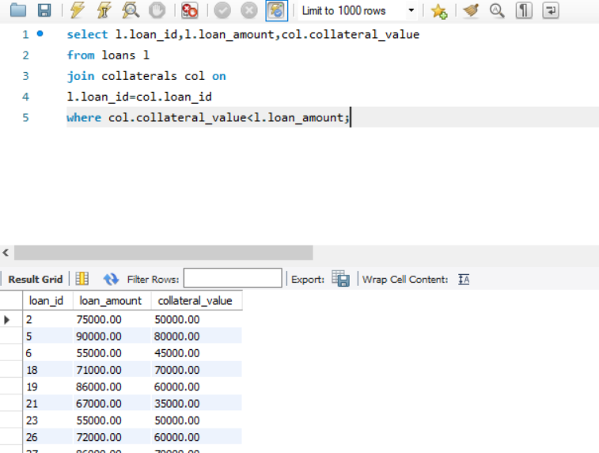
18.List all loans where the collateral value is less than the loan amount (Risk Analysis)

Slide 23
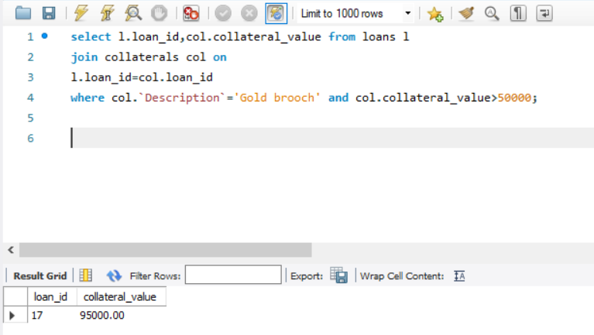
19.Retrieve loans with gold collateral exceeding a specific value

Slide 24
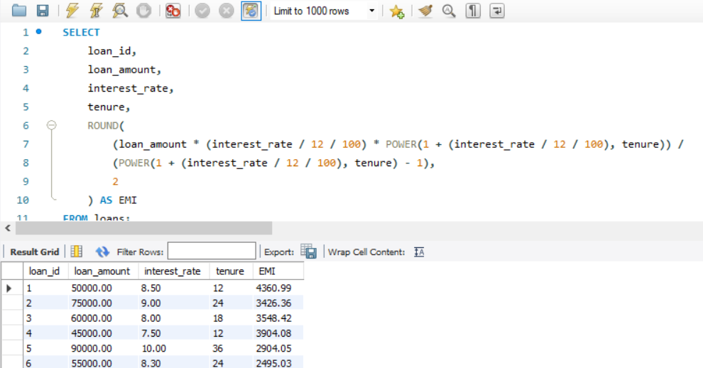
20.Claculate the monthly repayment amount(EMI) for all loans Formula EMI=P*R*(1+R)**N/(1+R)**N-1

Slide 25
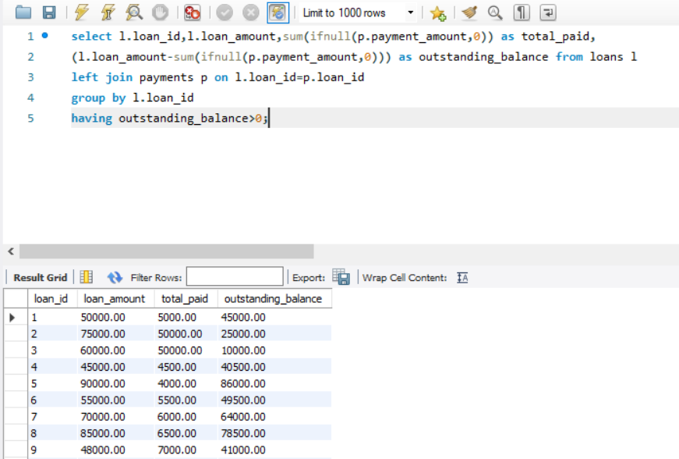
21.Find loans with payments in arrears (where outstanding balance>0)

Slide 26
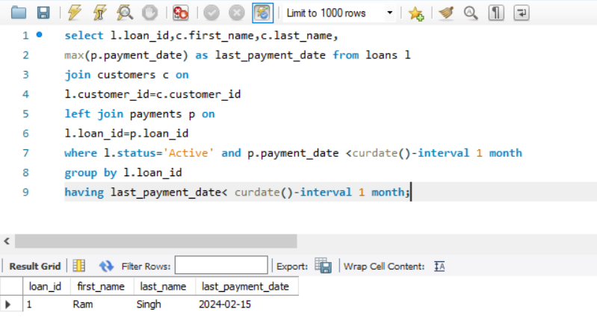
22.Identify loan with overdue payments

Slide 27
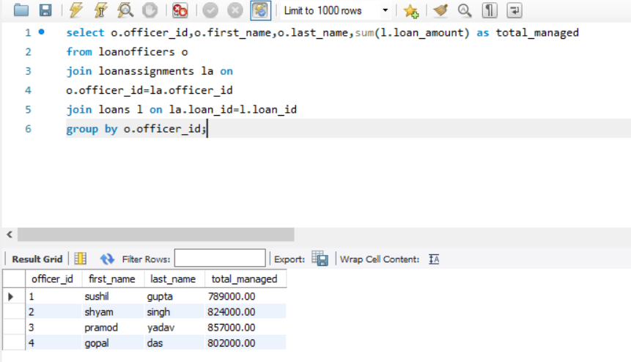
23.Find the loan amount managed by each loan officer

Slide 28
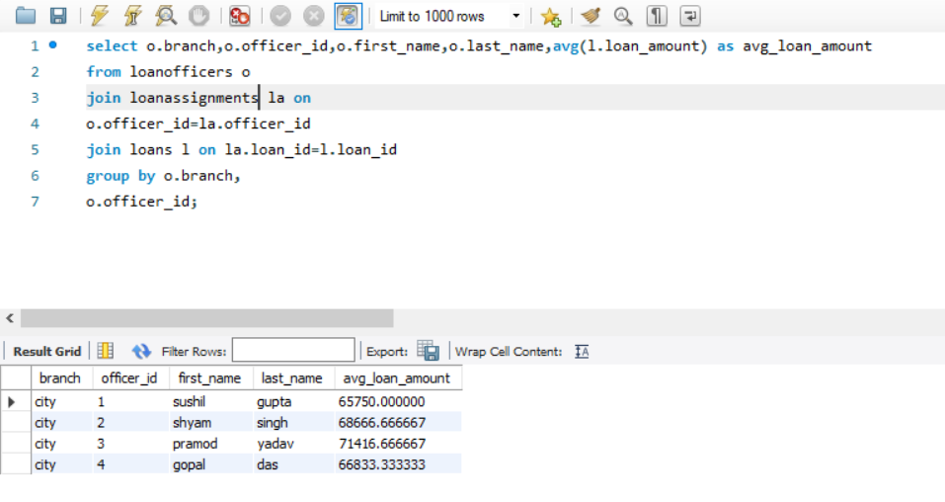
24.Calculate the average loan amount per officer per branch

Slide 29
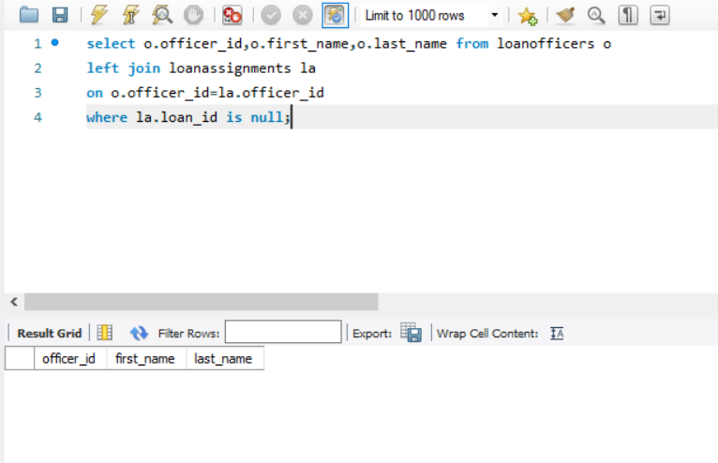
25.Identify officers with no loans assigned

Slide 30
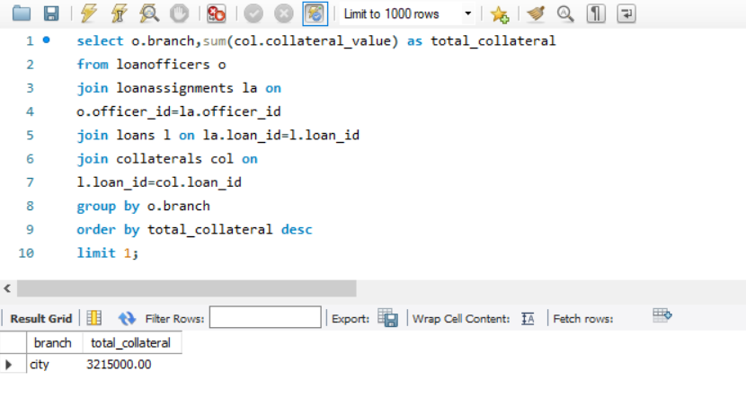
26.Find the branch with the highest total collateral value

Slide 31
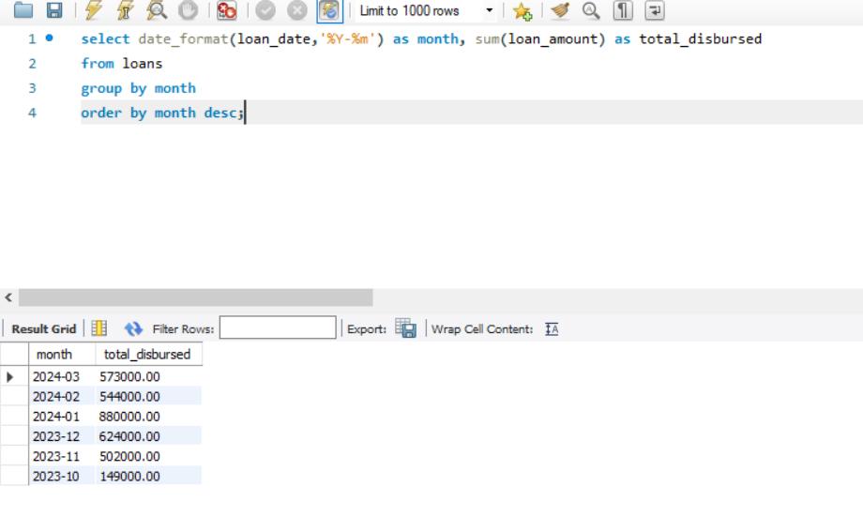
27.Show monthly loan disbursement totals

Slide 32
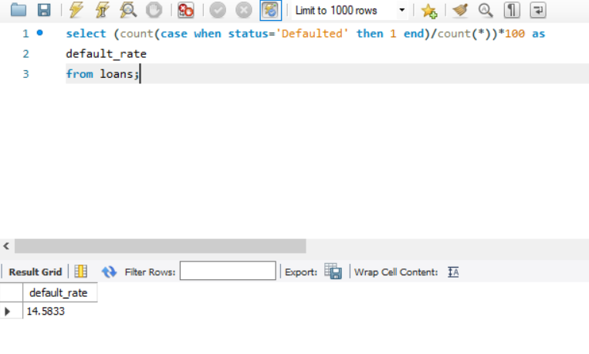
28.Calculate the default rate by counting loans marked as ‘Defaulted’

Slide 33
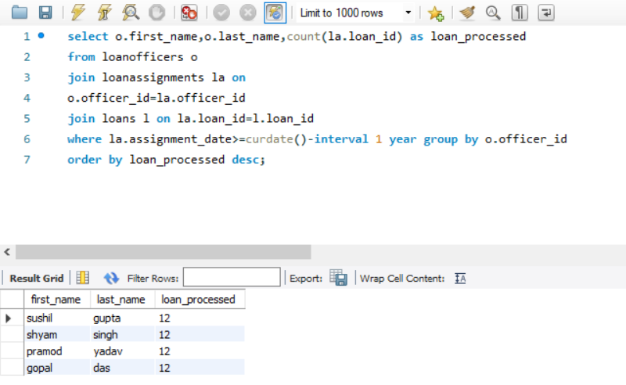
29.Find the number of loans processed by each officer over the last year

Slide 34
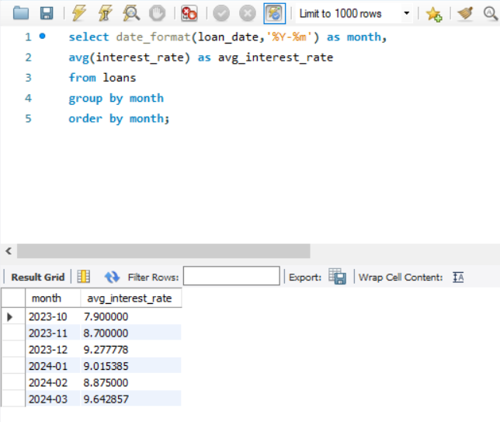
30.Identify trends in interest rates over time

Slide 35
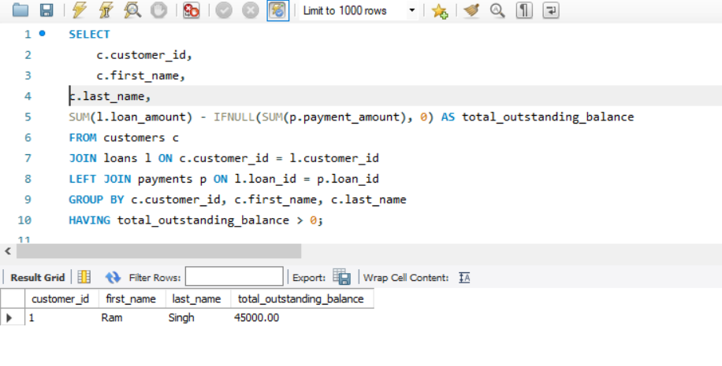
31.Calculate the total outstanding balance per customer

Slide 36
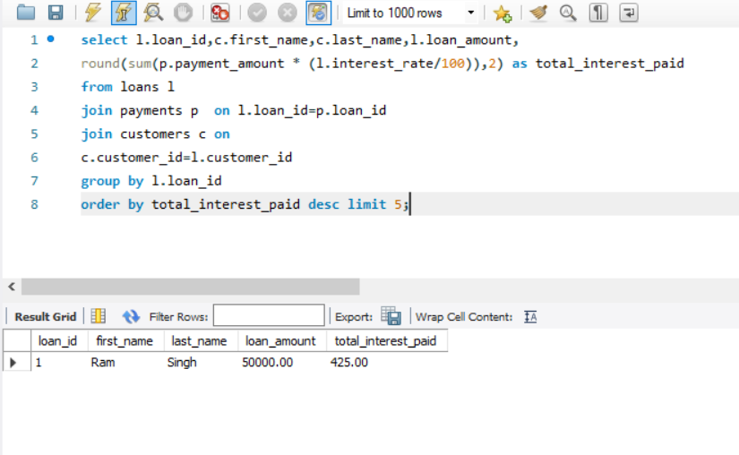
32.Identify loans with the highest interest paid to date

Slide 37
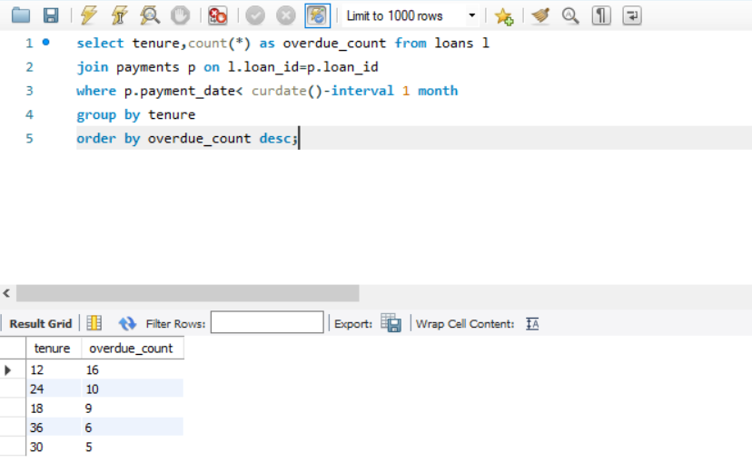
33.Analyze overdue payments by loan tenure (long vs short term)

Slide 38
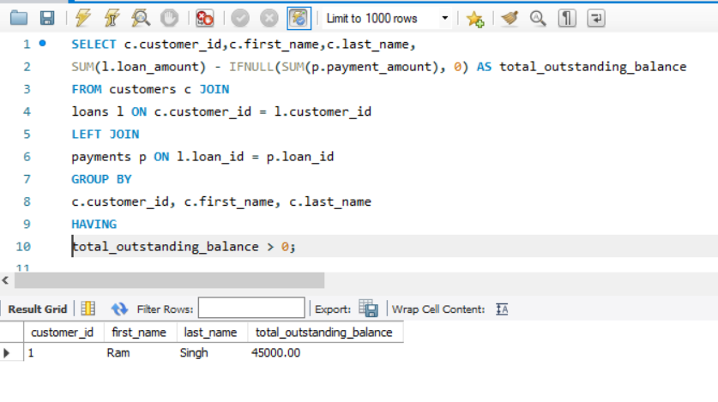
34.Track the average outstanding balance over time for active loans

Slide 39
Thank You
https://github.com/VirendraR2107/SQL-Analysis-Gold-Loan-/tree/main
https://www.linkedin.com/in/virendra-raikwar-3858992b4/

